Slide 1
Challenges and Opportunities for Rural and Downstate Development
One Shawnee Summit—October 11, 2024
Christopher D. Merrett, Ph.D.
Dean for Innovation and Economic Development
Director of the Illinois Institute for Rural Affairs
Western Illinois University
Macomb, IL 61455
cd-merrett@wiu.edu

Slide 2
Purpose Outline
Provide an overview of rural and downstate economic development
Strategies to address rural and small town development challenges
Defining “Rural”
Rural Trends
Planning for Rural Development
Conclusions

Slide 3
I. Defining Rural
Not as easy to define as you might think…
Multiple ways to define “rural” depending on the federal agency
US Census Bureau and USDA-Economic Research Service (ERS) typically rely on the federal OMB definition:
County is metro (or urban) if it has a core urban area > 50,000 residents
Adjacent counties are also metro if 25% of their population commutes to the urban core or if 25% of workers commute in from urban core
Counties outside metro areas are nonmetro but we can divide this into nonmetro (micropolitan—10,000 to 49,999) and nonmetro (non-core)
Source: https://www.ers.usda.gov/topics/rural-economy-population/rural-classifications/what-is-rural.aspx

Slide 4
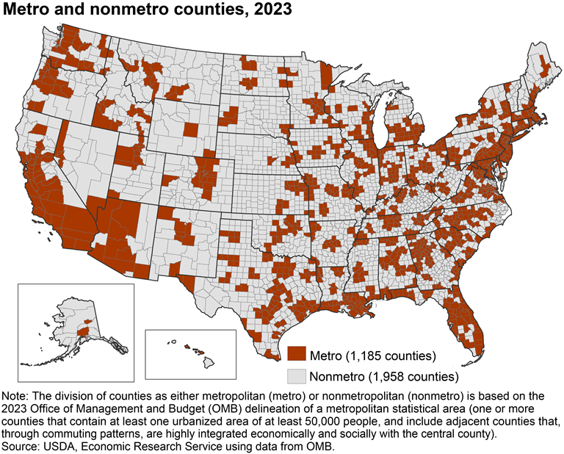

Slide 5
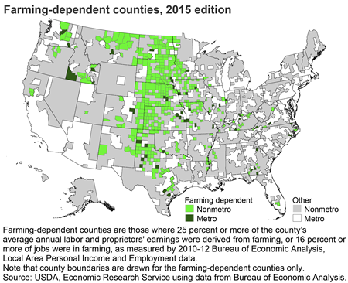
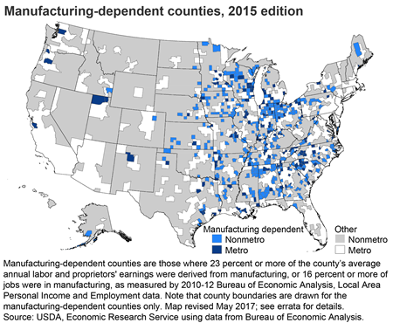
I. Rural Economic Diversity

Slide 6
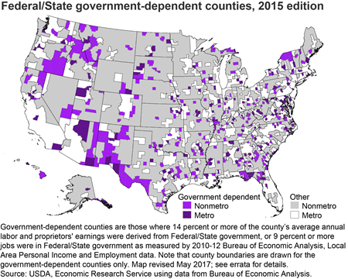
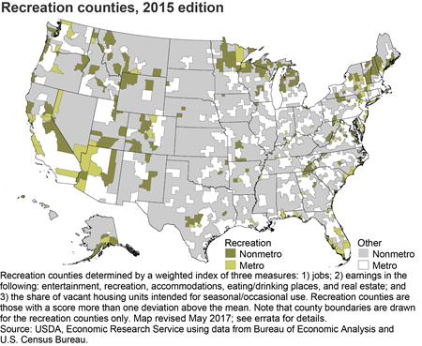
I. Rural Economic Diversity

Slide 7
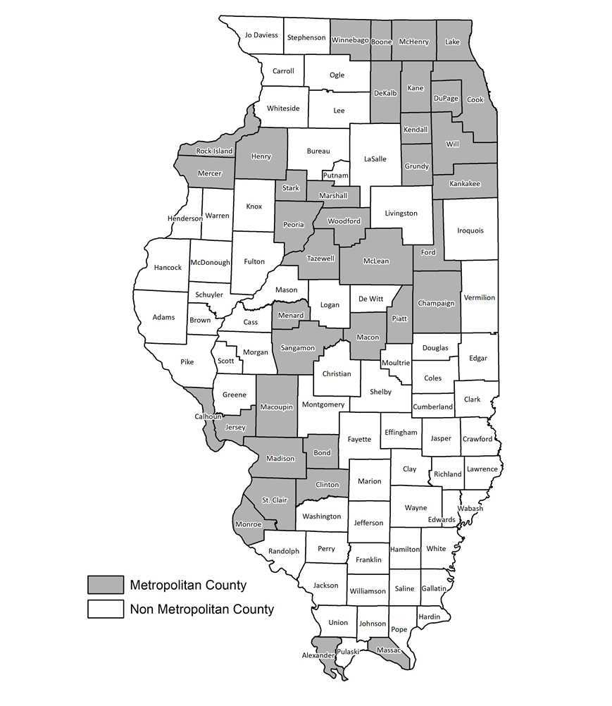
II. Rural Population Trends Metro vs Nonmetro Counties
US has 3,143 counties: 1,185 metro and 1,958 non-metro counties
Most Americans (80%) in metro counties
Most of the land is non-metro counties
2020 US Census: 53% of counties lost population – almost all were rural
Many non-metro county populations have declined for decades
Long term population decline in rural and downstate counties
Is an ongoing challenge with significant socioeconomic impacts

Slide 8
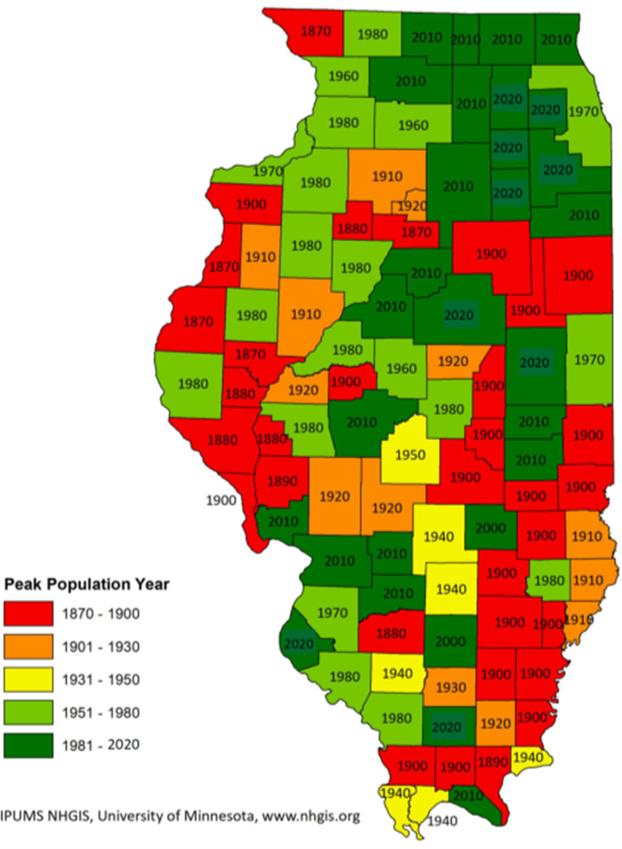
II. Rural Demographics
Drivers of population decline:
Mechanization / Decline of:
Agriculture
Mining
Forestry
Declining birthrates
Slowed immigration
Rural outmigration – youth outmigration
Globalization
Off-shoring manufacturing
Macroscale processes

Slide 9
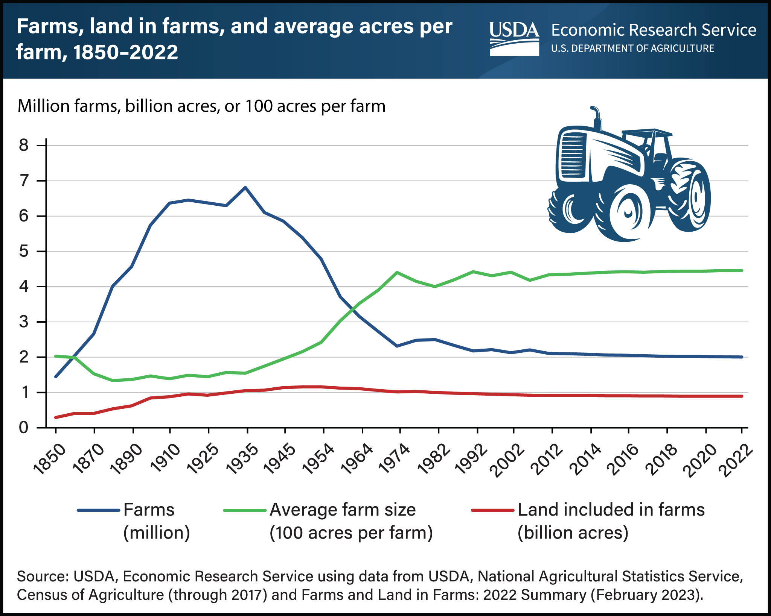
Technological Change and Rural Development
Farm numbers peaked at 6.8 million in 1935
Average farm size increased from 155 acres in 1935 to 446 acres in 2022
2.0 million farms are currently in operation

Slide 10
II. Index of Population Change by County Type

Slide 11
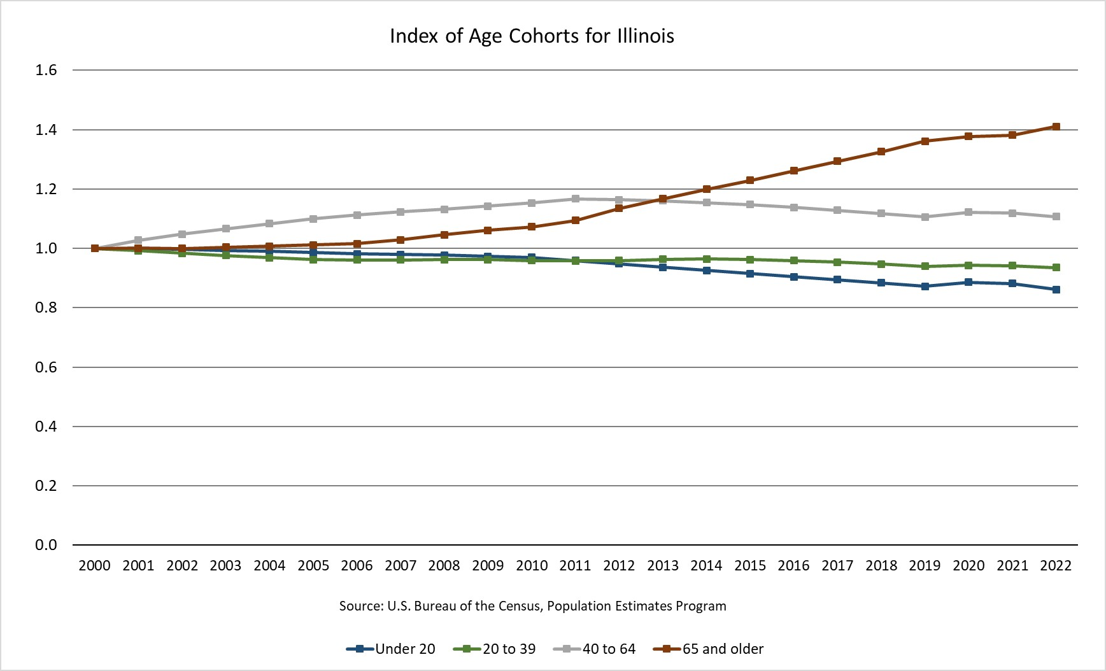
Fastest Growing Age Cohort is +65
Fastest Shrinking Age Cohort is < 20

Slide 12
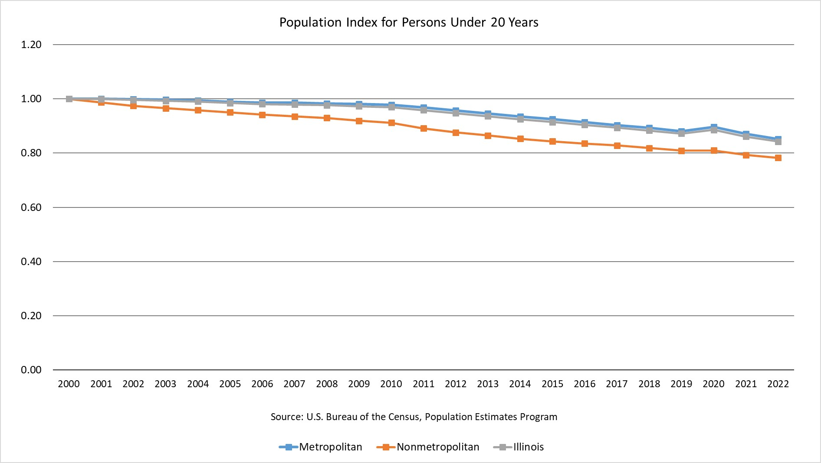
Fastest Shrinking Cohort is Rural < 20 Years of Age

Slide 13
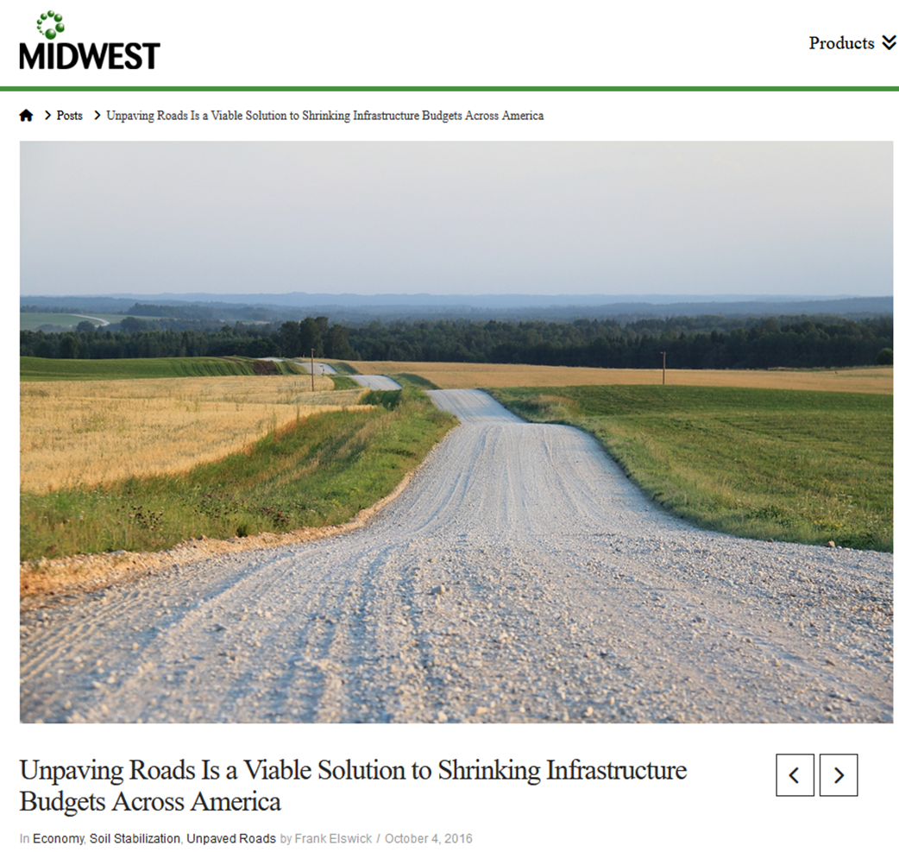
II. Impacts of Rural & Downstate Depopulation
Loss of anchor institutions (e.g., grocery stores, hospitals, schools)
Declining tax base – but fixed infrastructure costs
Loss of talent – Workforce development issues
Educational attainment gap
Digital divide is real
Rural poverty
Aging population
Mobility issues
Healthcare access
Rising “deaths of despair”
Quality of life issues

Slide 15
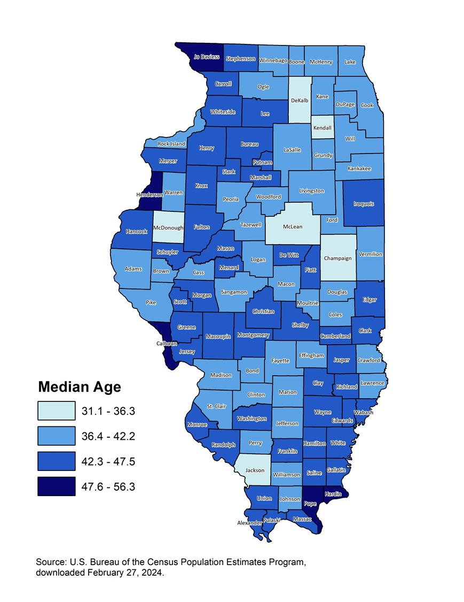
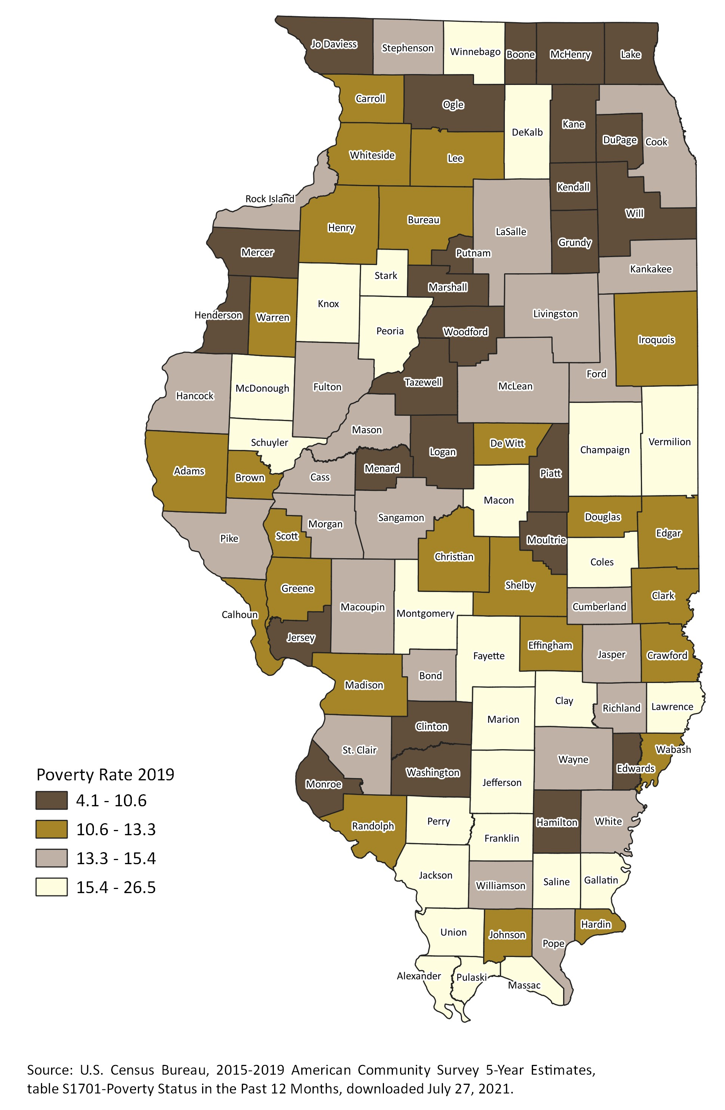
Median Age
Poverty Rate
Healthcare access
Access to Higher Ed
Mobility

Slide 18
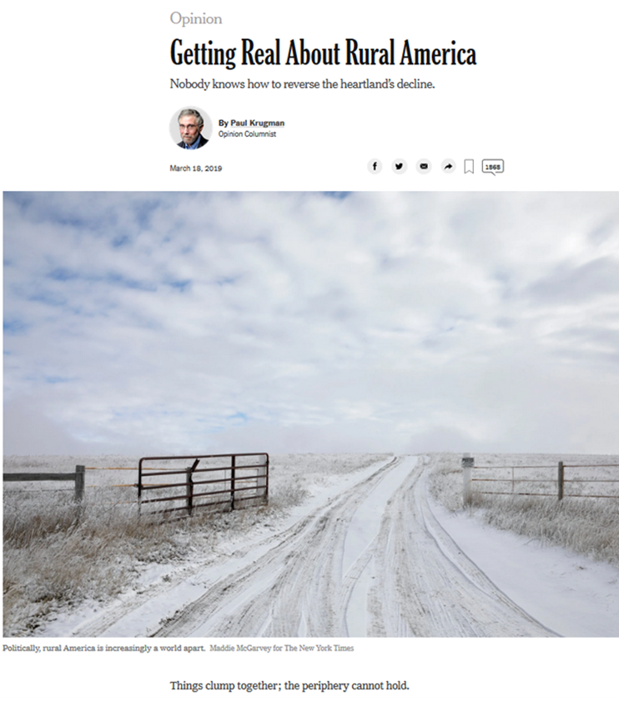
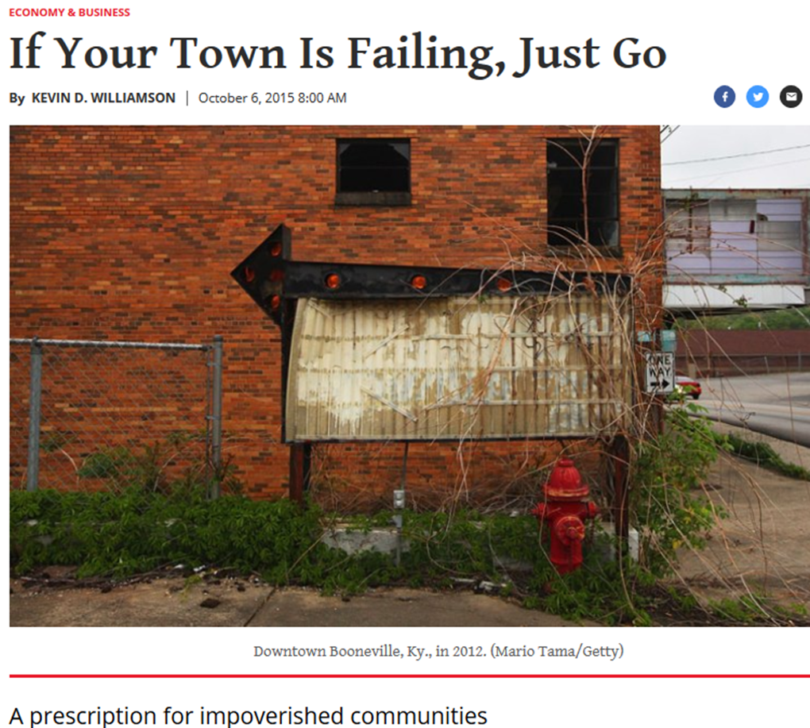

Slide 19
III. The IIRA – Promoting Rural Development
Pushing back against the negative narrative of rural development
Focus on assets, not needs, of a community
ABCD = Asset Based Community Development
IIRA Founded in 1989 at Western Illinois University
IL Governor’s Executive Order describes the IIRA as the, “State’s academic clearinghouse for rural development data and initiatives”
Research
Teaching
Policy Development
Outreach
Works with the Governor’s Rural Affairs Council (GRAC)
Solution-oriented “think and do” tank
Confront pessimism and the underlying “psychology of decline”

Slide 23
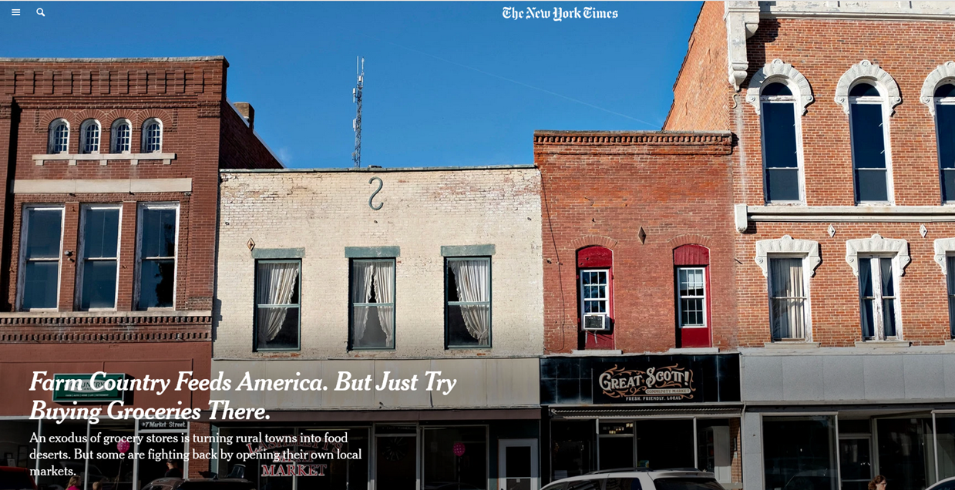
Source: https://www.nytimes.com/2019/11/05/us/rural-farm-market.html

Slide 26
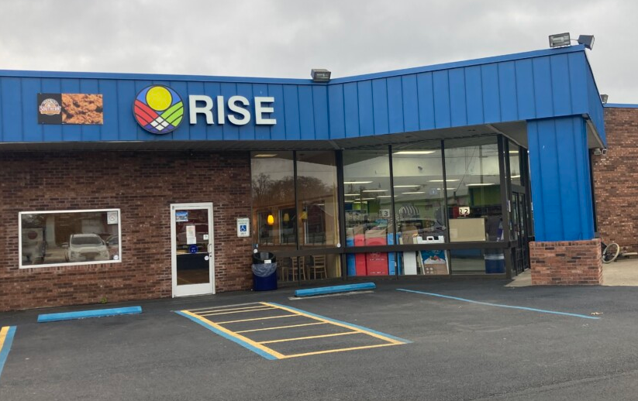

Slide 27
III. Other Local and State Approaches
Governors Rural Affairs Council – Chaired by Lt. Governor Juliana Stratton
IIRA Rural Development Resource Guide: https://iira.org/rural-resource-guide/

Slide 28
III. Other Local and State Approaches
UI Extension – Great asset for community development
Corn Belt Ports Initiative – Bob Sinkler
Remote Worker Recruitment – Alex Benishek
Youth Retention and Recruitment—Higher Education
Promise Programs
Keep college-aged students local with promise of free or low-cost tuition
Kalamazoo Promise: https://www.kalamazoopromise.com/
Peoria Promise: https://www.peoriapromise.org/
Higher Education IS Economic Development—BR&E for Illinois Students
Treat Illinois Students like DCEO Treats Businesses – Our future depends on it
DCEO spends $$$ to keep businesses in IL and recruit new businesses into IL
Illinois should do the same for college-aged residents of the Midwest
Illinois should be net importer of college-aged students

Slide 29
III. Federal Strategies
How else could we address rural and downstate depopulation?
Increase support for USDA Rural Development programs
Paradox of federal support for rural communities
USDA investments in exports and efficiencies spur farm consolidation and rural depopulation
Majority of farm households need off-farm employment – need diverse rural economy
USDA-RD investments support rural non-farm economy
Recent Farm Bills increase money for programs that promote export and efficiencies and cut support for USDA-RD and non-farm rural development
This only accelerates rural depopulation.
Immigration Reform
Research based on 2010 US Census showed that many rural counties had stabilized or even slightly increased population due to influx of immigrants from Mexico and Central America
Mayor from Ulysses, Kansas, acknowledged that rural depopulation is a huge problem. Hispanic influx has overall been a good thing for rural places. He said that:
“Immigration is happening and the communities that extend a hand are going to survive” (NY Times 2011)

Slide 30
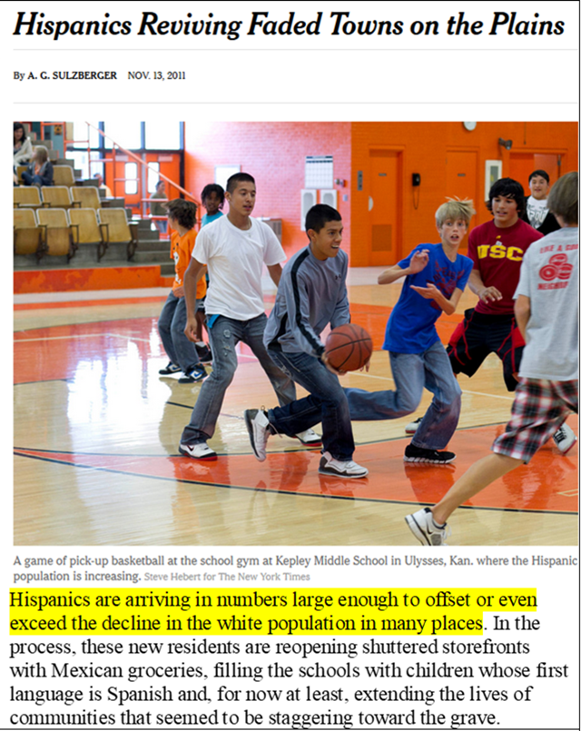

Slide 31
IV. Summary and Conclusions
Rural Midwest is a diverse region
Rural and downstate places confront challenges at multiple scales
Local efforts are a necessary but insufficient remedy
Need support and action at multiple levels
Local
State
Federal
Rural Development is a complex challenge AND opportunity
Local and regional collaboration is part of the solution
One Shawnee is a great example of regional collaboration!
Questions and comments welcome!

